Slide 1
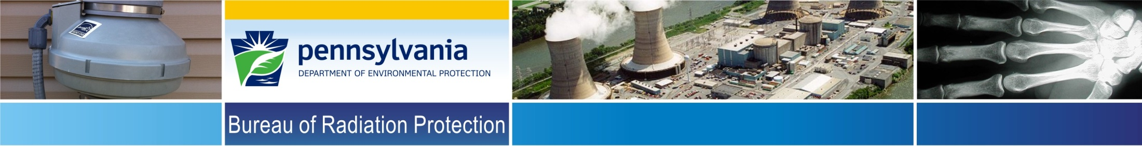
PA DEP/BRP, Radon Division
Mid-Atlantic States Radiation Conference
Bob Lewis
Radon Division, Program Manager

Slide 2
PA DEP/BRP, Radon Division
Exploratory Study of ASD Ground Level Exhaust on Radon
Re-entrainment.

Slide 3

DEP/BRP Radon Division
Re-entrainment
The unintended entry of radon gas from a ASD exhaust pipe back into one’s home or structure.
Notes:
ER = (WL x 100)/ Rn

Slide 4
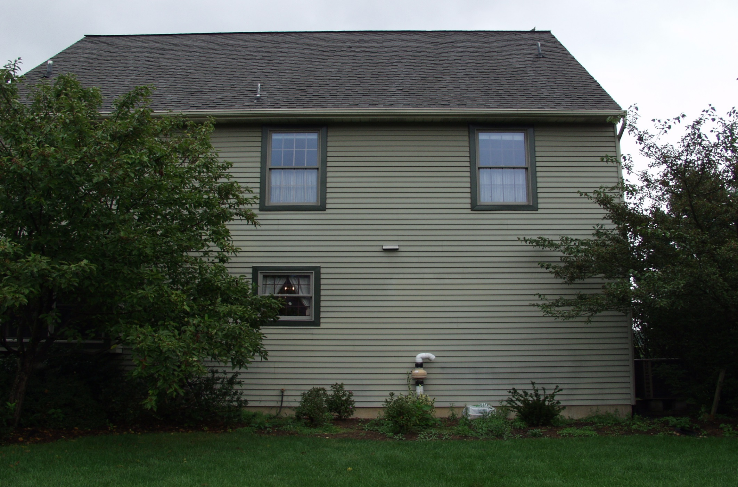
DEP/BRP Radon Division
Notes:
ER = (WL x 100)/ Rn

Slide 5
DEP/BRP Radon Division
PA Radon Mitigation Standards
14.2.8 To prevent re-entrainment of radon, the point of discharge from vents of ASD systems shall meet all of the following requirements: be above the eave of the roof…
Notes:
ER = (WL x 100)/ Rn

Slide 6
DEP/BRP Radon Division
Do we have to discharge to roof line all the time?
That is what the study is designed to answer, in part.
We don’t think that roof line discharge is always necessary.
Notes:
ER = (WL x 100)/ Rn

Slide 7
DEP/BRP Radon Division
Reasons for Ground Level Discharge
Aesthetics
Safety for installer
Cost
Efficiency
Less condensation
Notes:
ER = (WL x 100)/ Rn

Slide 8
DEP/BRP Radon Division
Early Studies showed that re-entrainment could lead to increased indoor radon.
Modeling studies showed that radon could accumulate on the face of the building under certain circumstances.
PSU used tracer gas from a mock ASD exhaust point with eave and ground level exhaust. The GLE did contribute more to indoor radon than the eave.
Notes:
First study dealt with relatively high exhaust gas concentrations, second study was just a modeling study , and the PSU study was just from one house.

Slide 9
DEP/BRP Radon Division
The Studies continued:
  The studies did conclude that ground level exhaust may be acceptable when the concentrations are not too high and the exhaust point is ninety degrees pointed away from the house.
Notes:
First study dealt with relatively high exhaust gas concentrations, second study was just a modeling study , and the PSU study was just from one house.

Slide 10
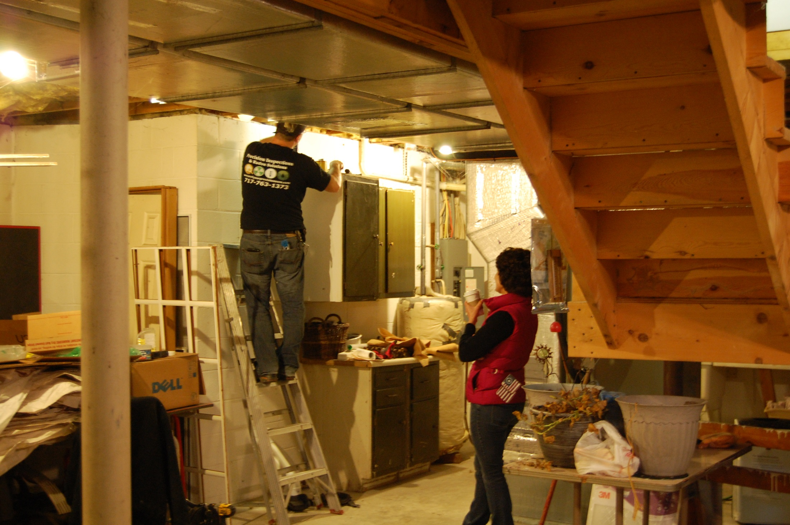
DEP/BRP Radon Division
Notes:
ER = (WL x 100)/ Rn

Slide 11
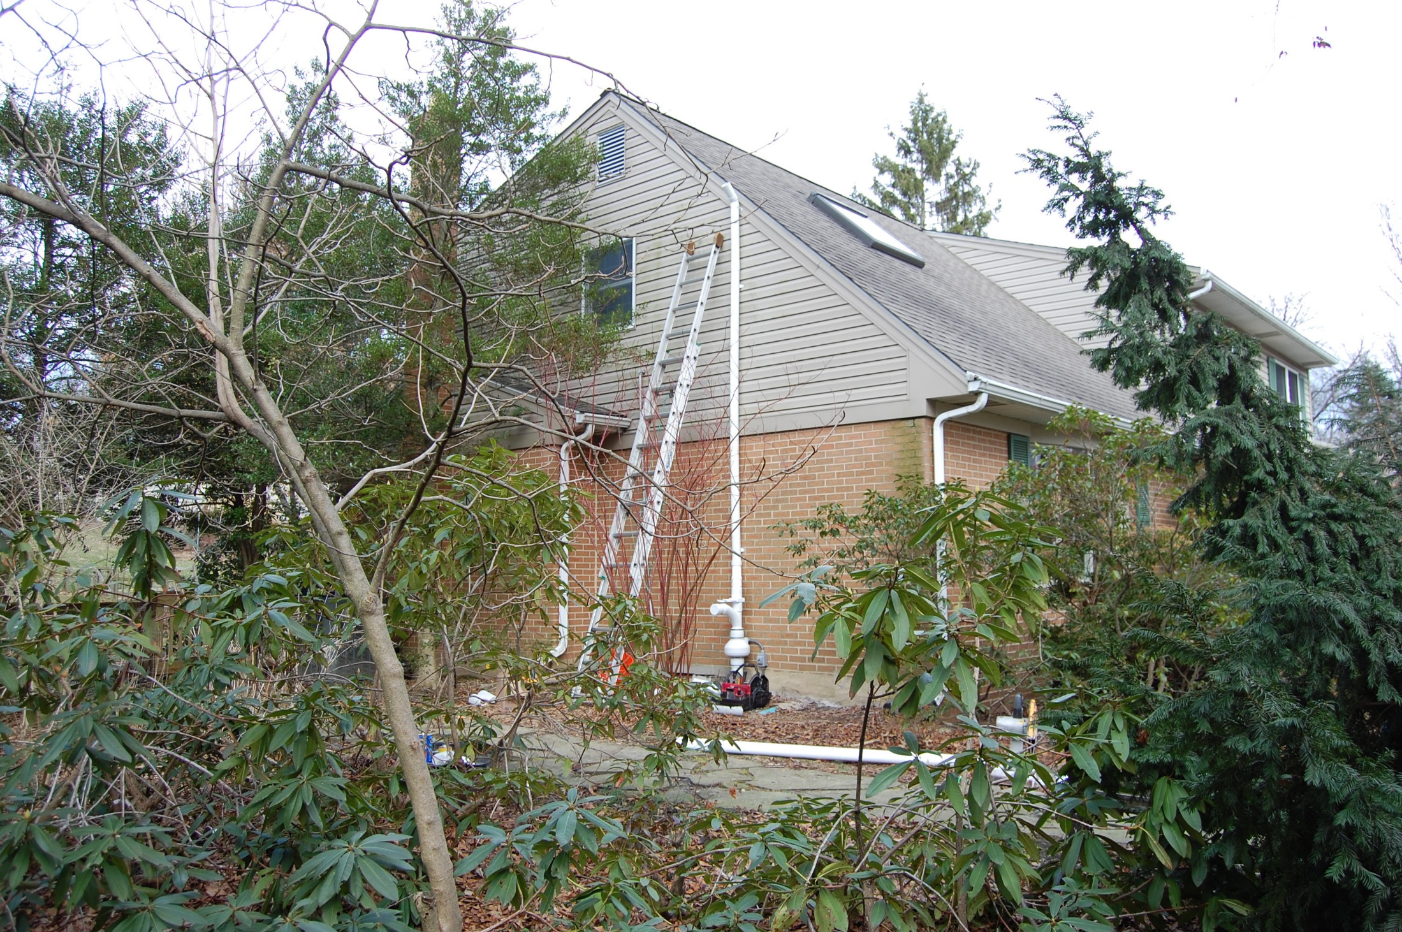
DEP/BRP Radon Division
Notes:
ER = (WL x 100)/ Rn

Slide 12
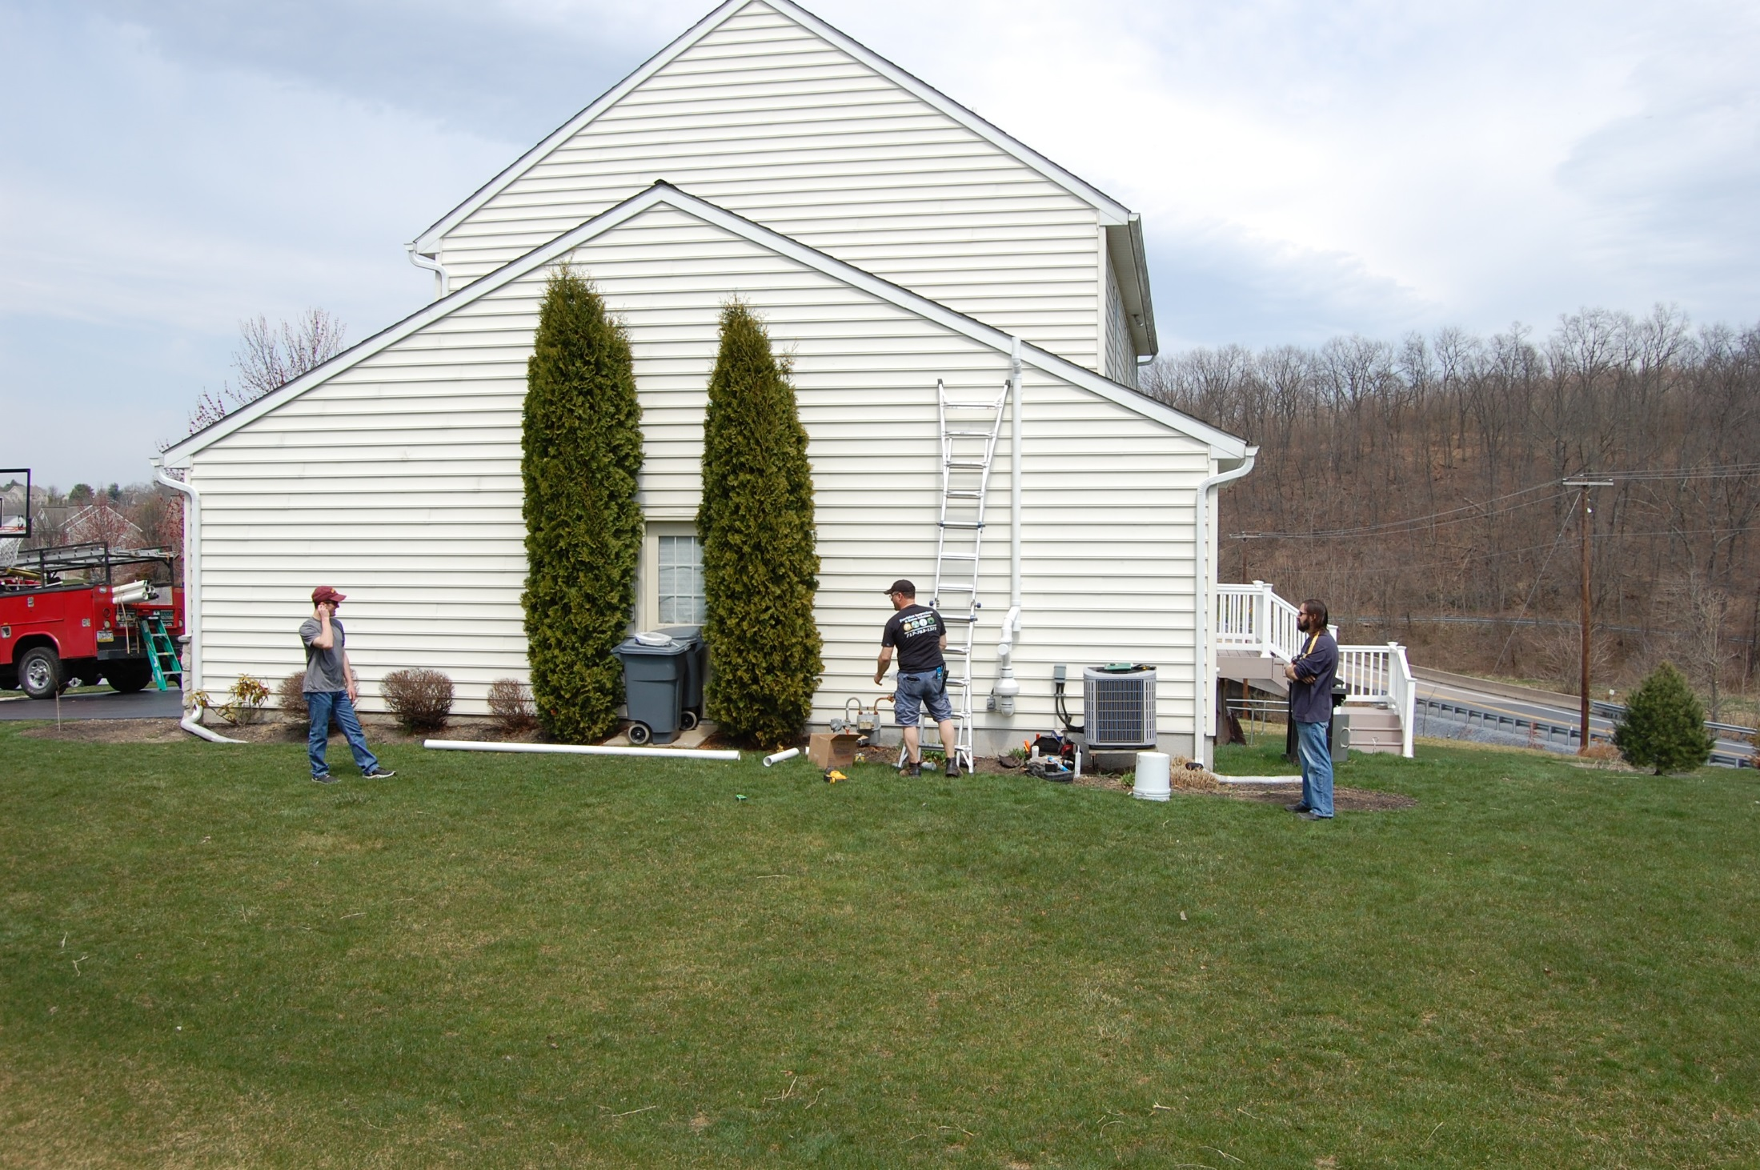
DEP/BRP Radon Division
Notes:
ER = (WL x 100)/ Rn

Slide 13
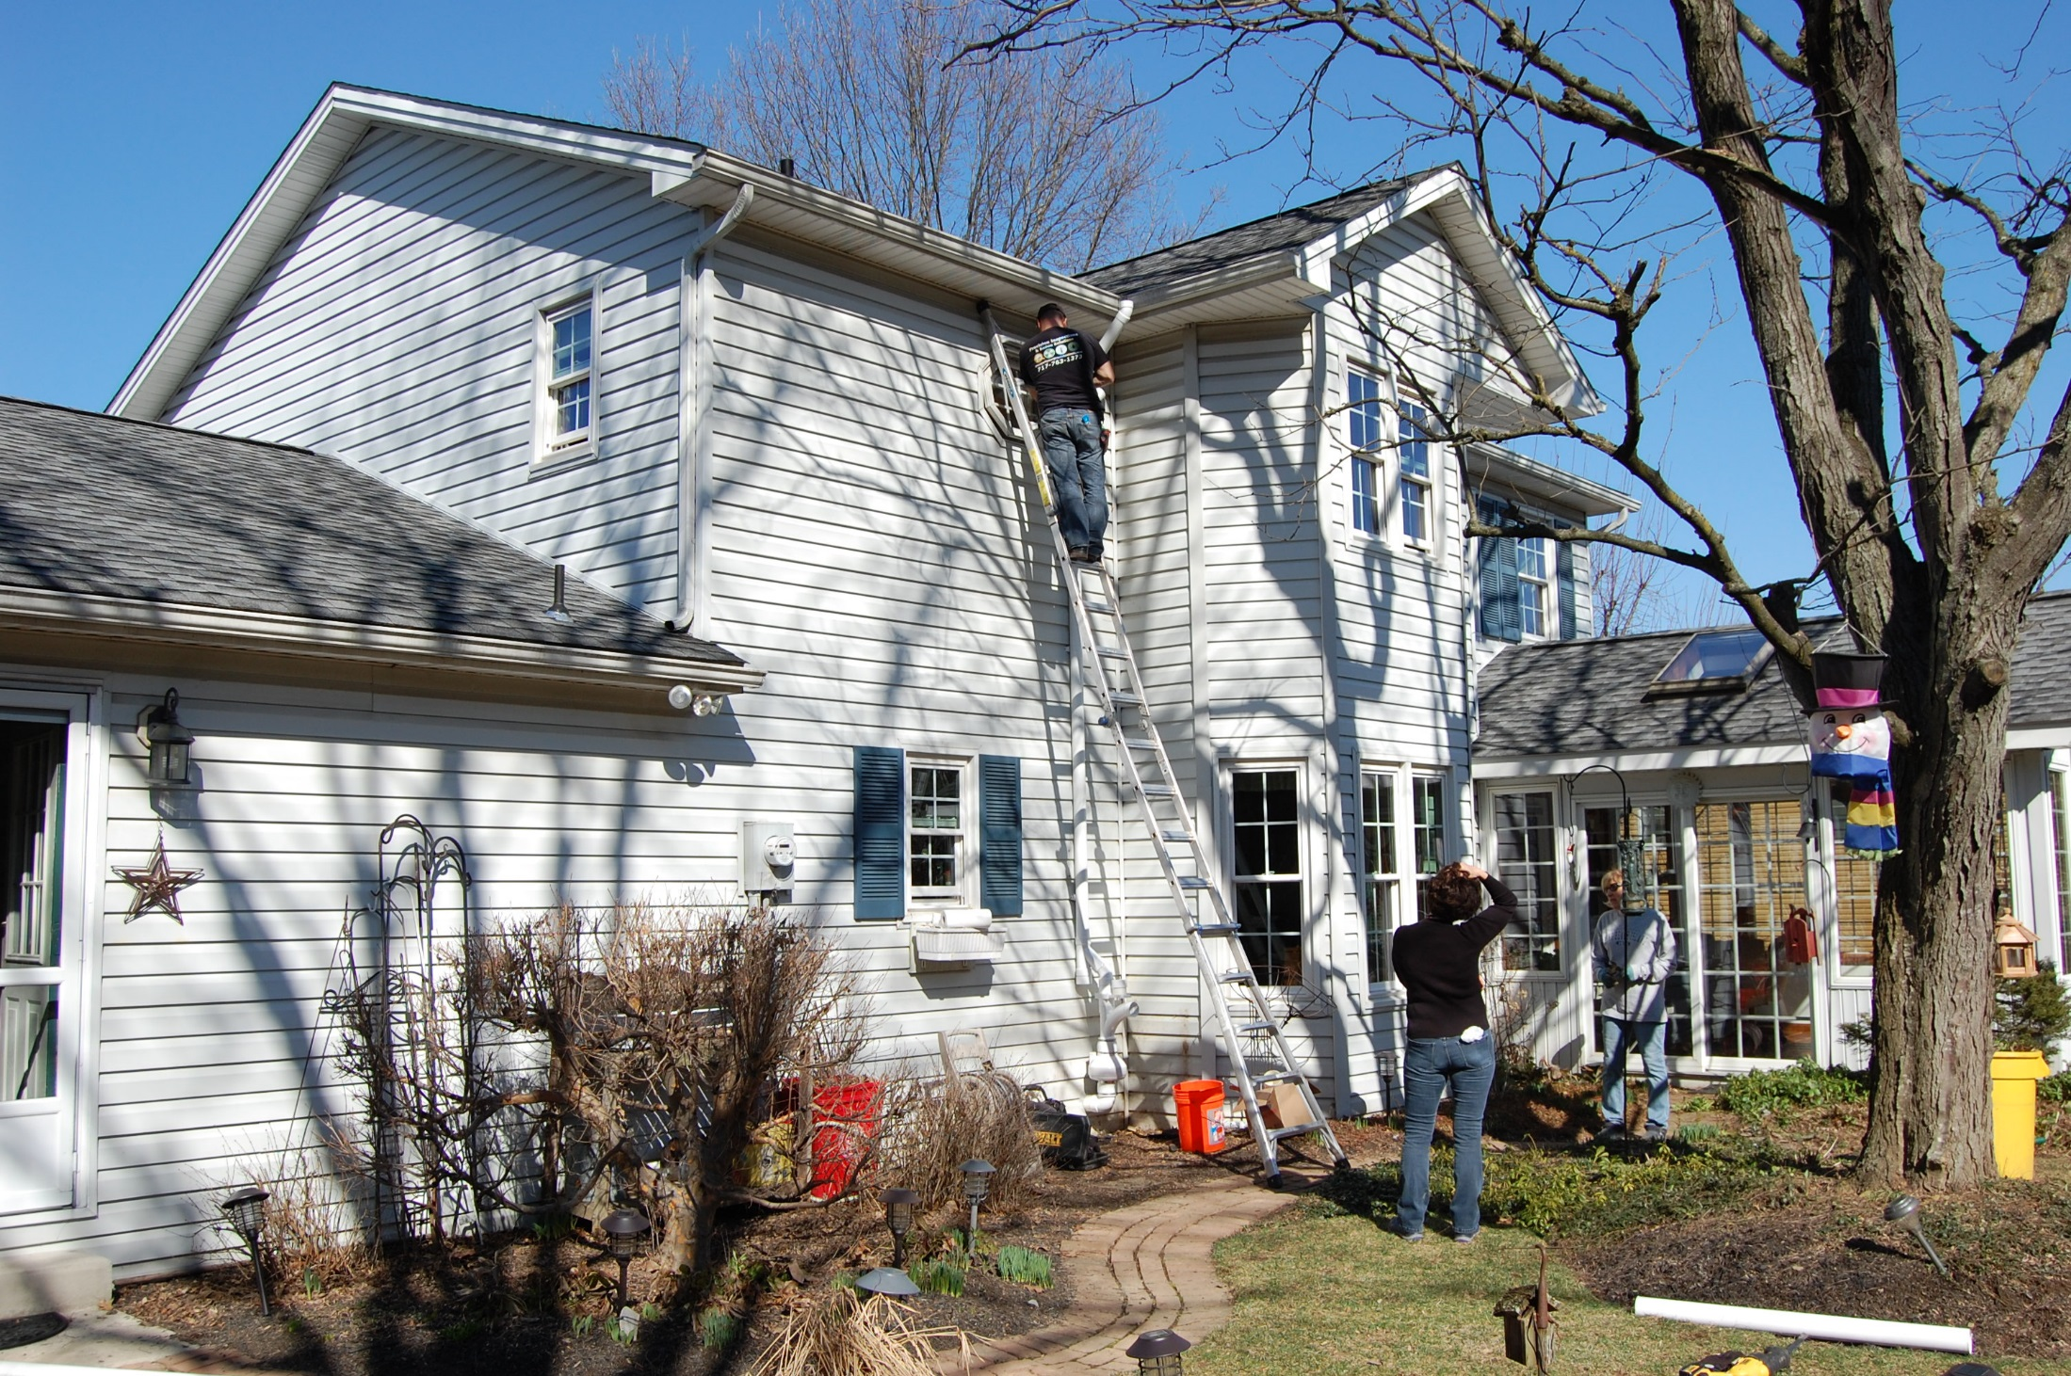
DEP/BRP Radon Division
Notes:
ER = (WL x 100)/ Rn

Slide 14
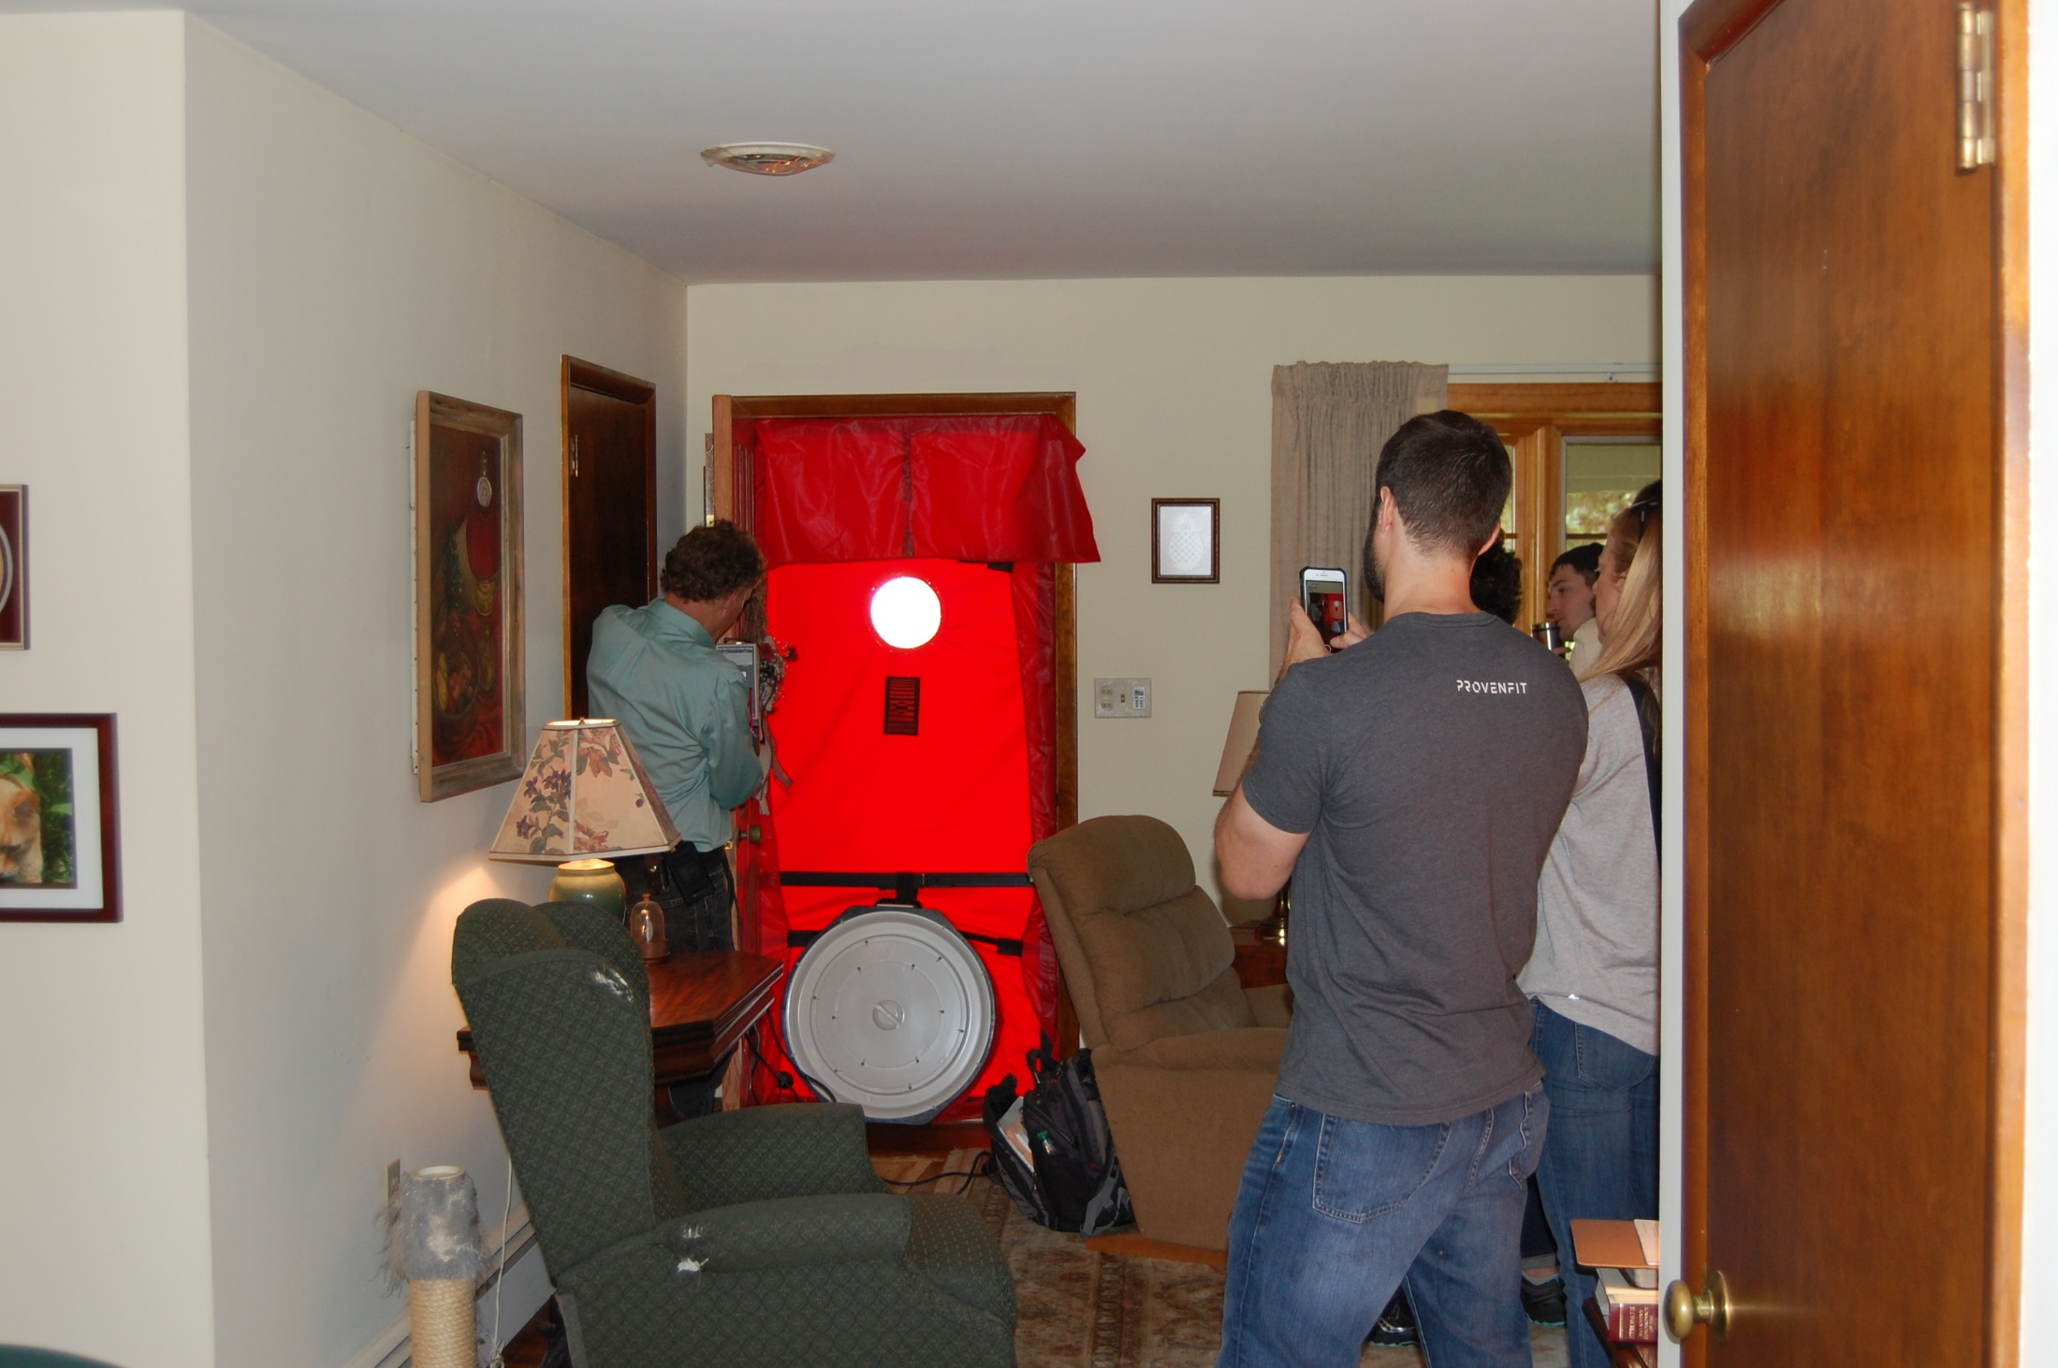
DEP/BRP Radon Division
Notes:
ER = (WL x 100)/ Rn

Slide 15
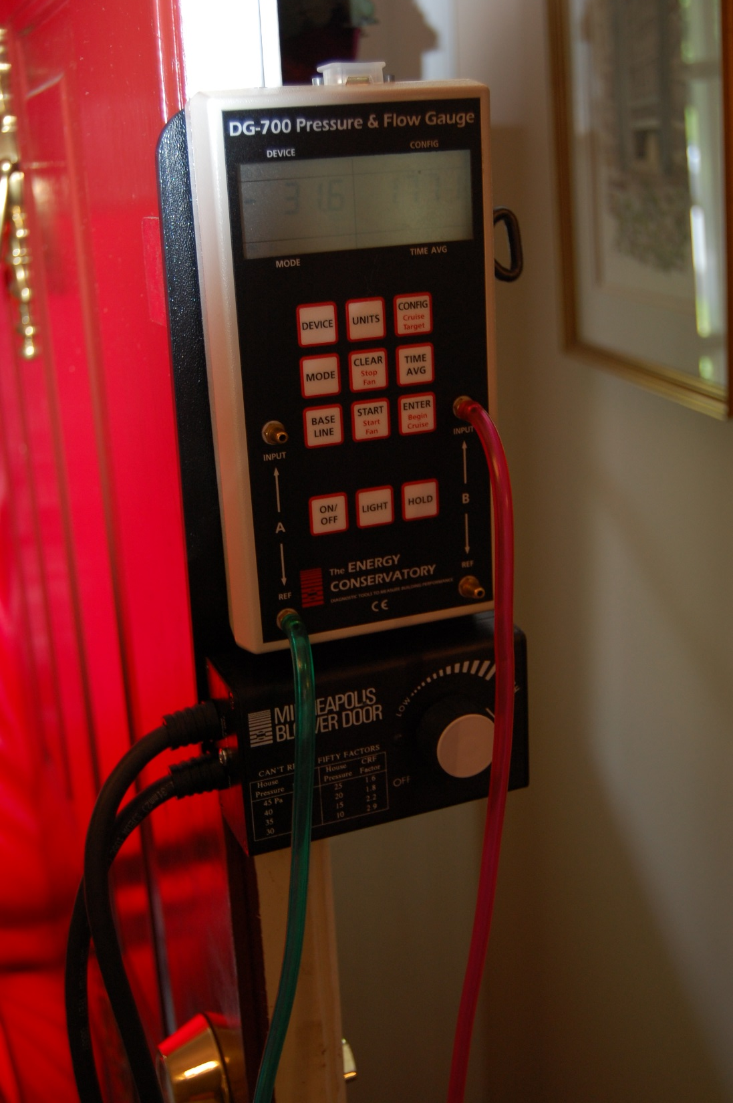
DEP/BRP Radon Division
Notes:
ER = (WL x 100)/ Rn

Slide 16
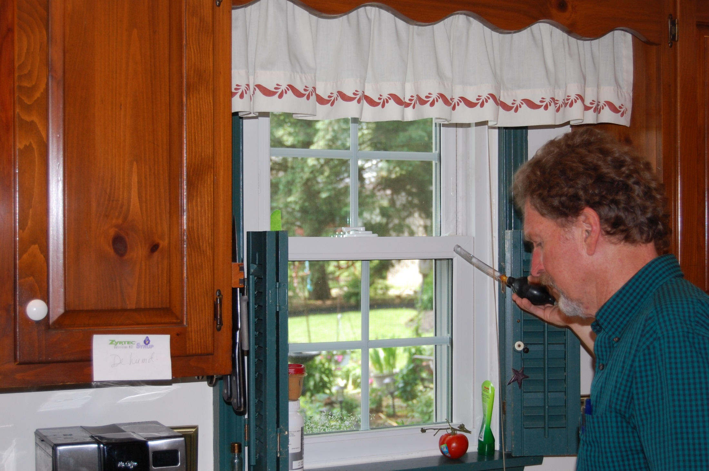
DEP/BRP Radon Division
Notes:
ER = (WL x 100)/ Rn

Slide 17
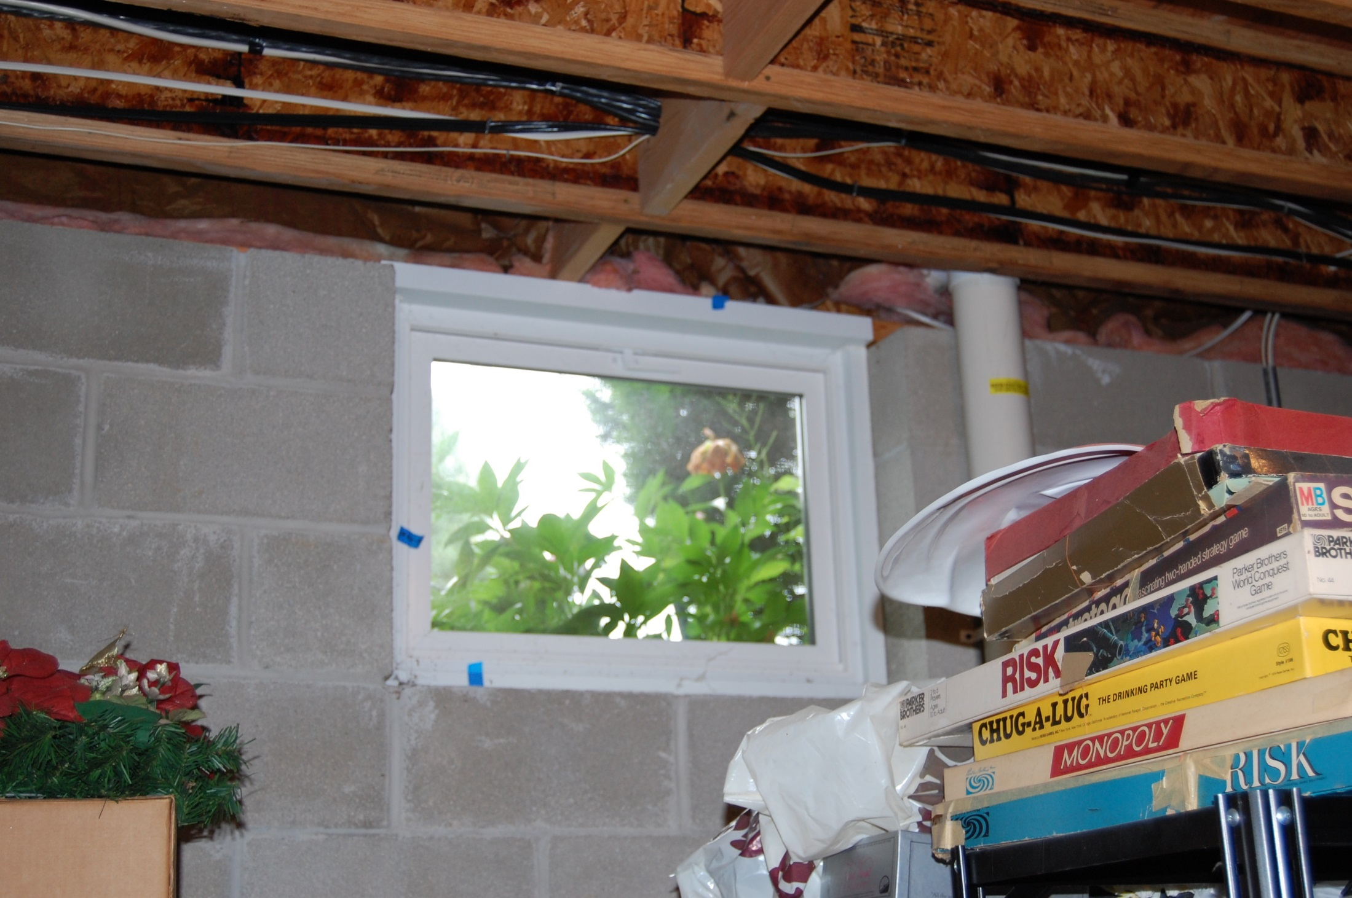
DEP/BRP Radon Division
Notes:
ER = (WL x 100)/ Rn

Slide 18
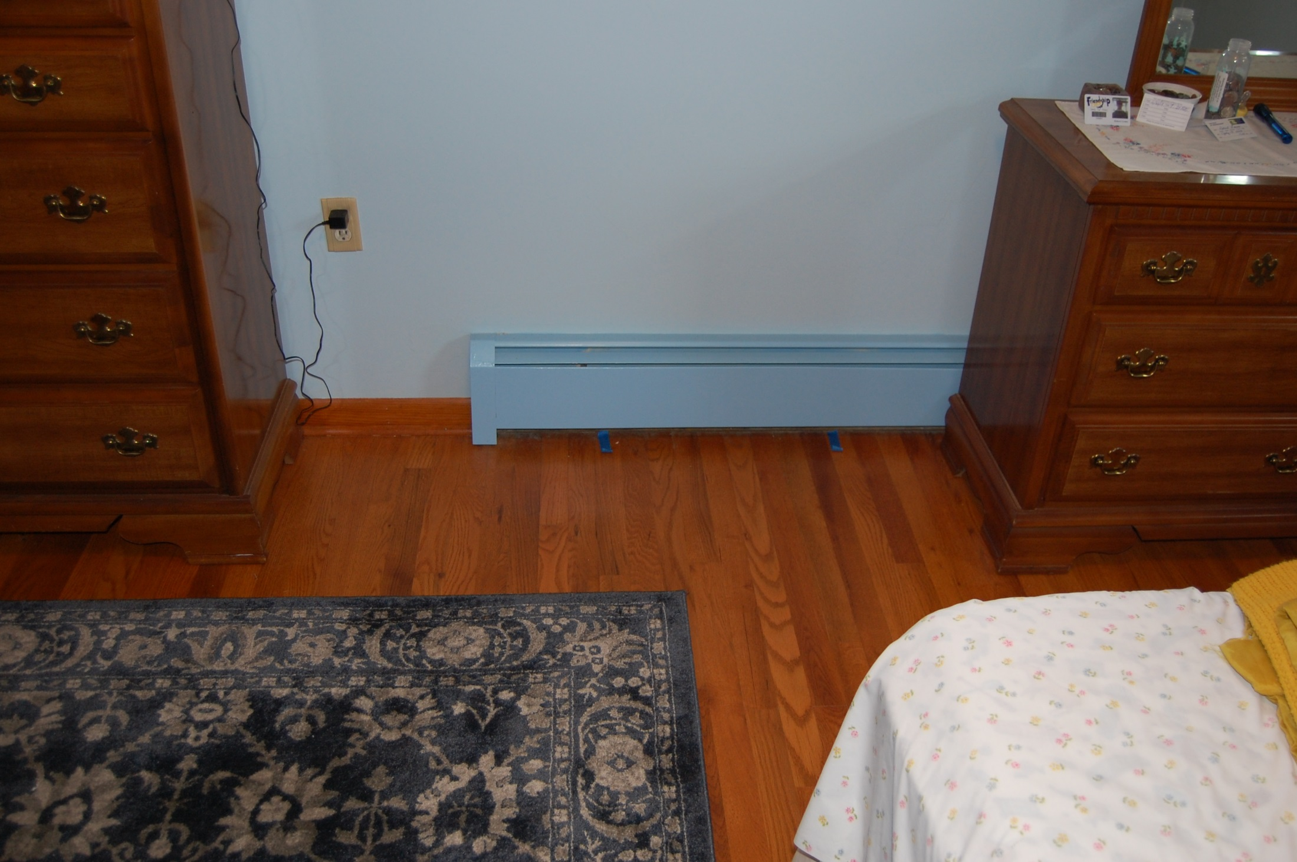
DEP/BRP Radon Division
Notes:
ER = (WL x 100)/ Rn

Slide 19
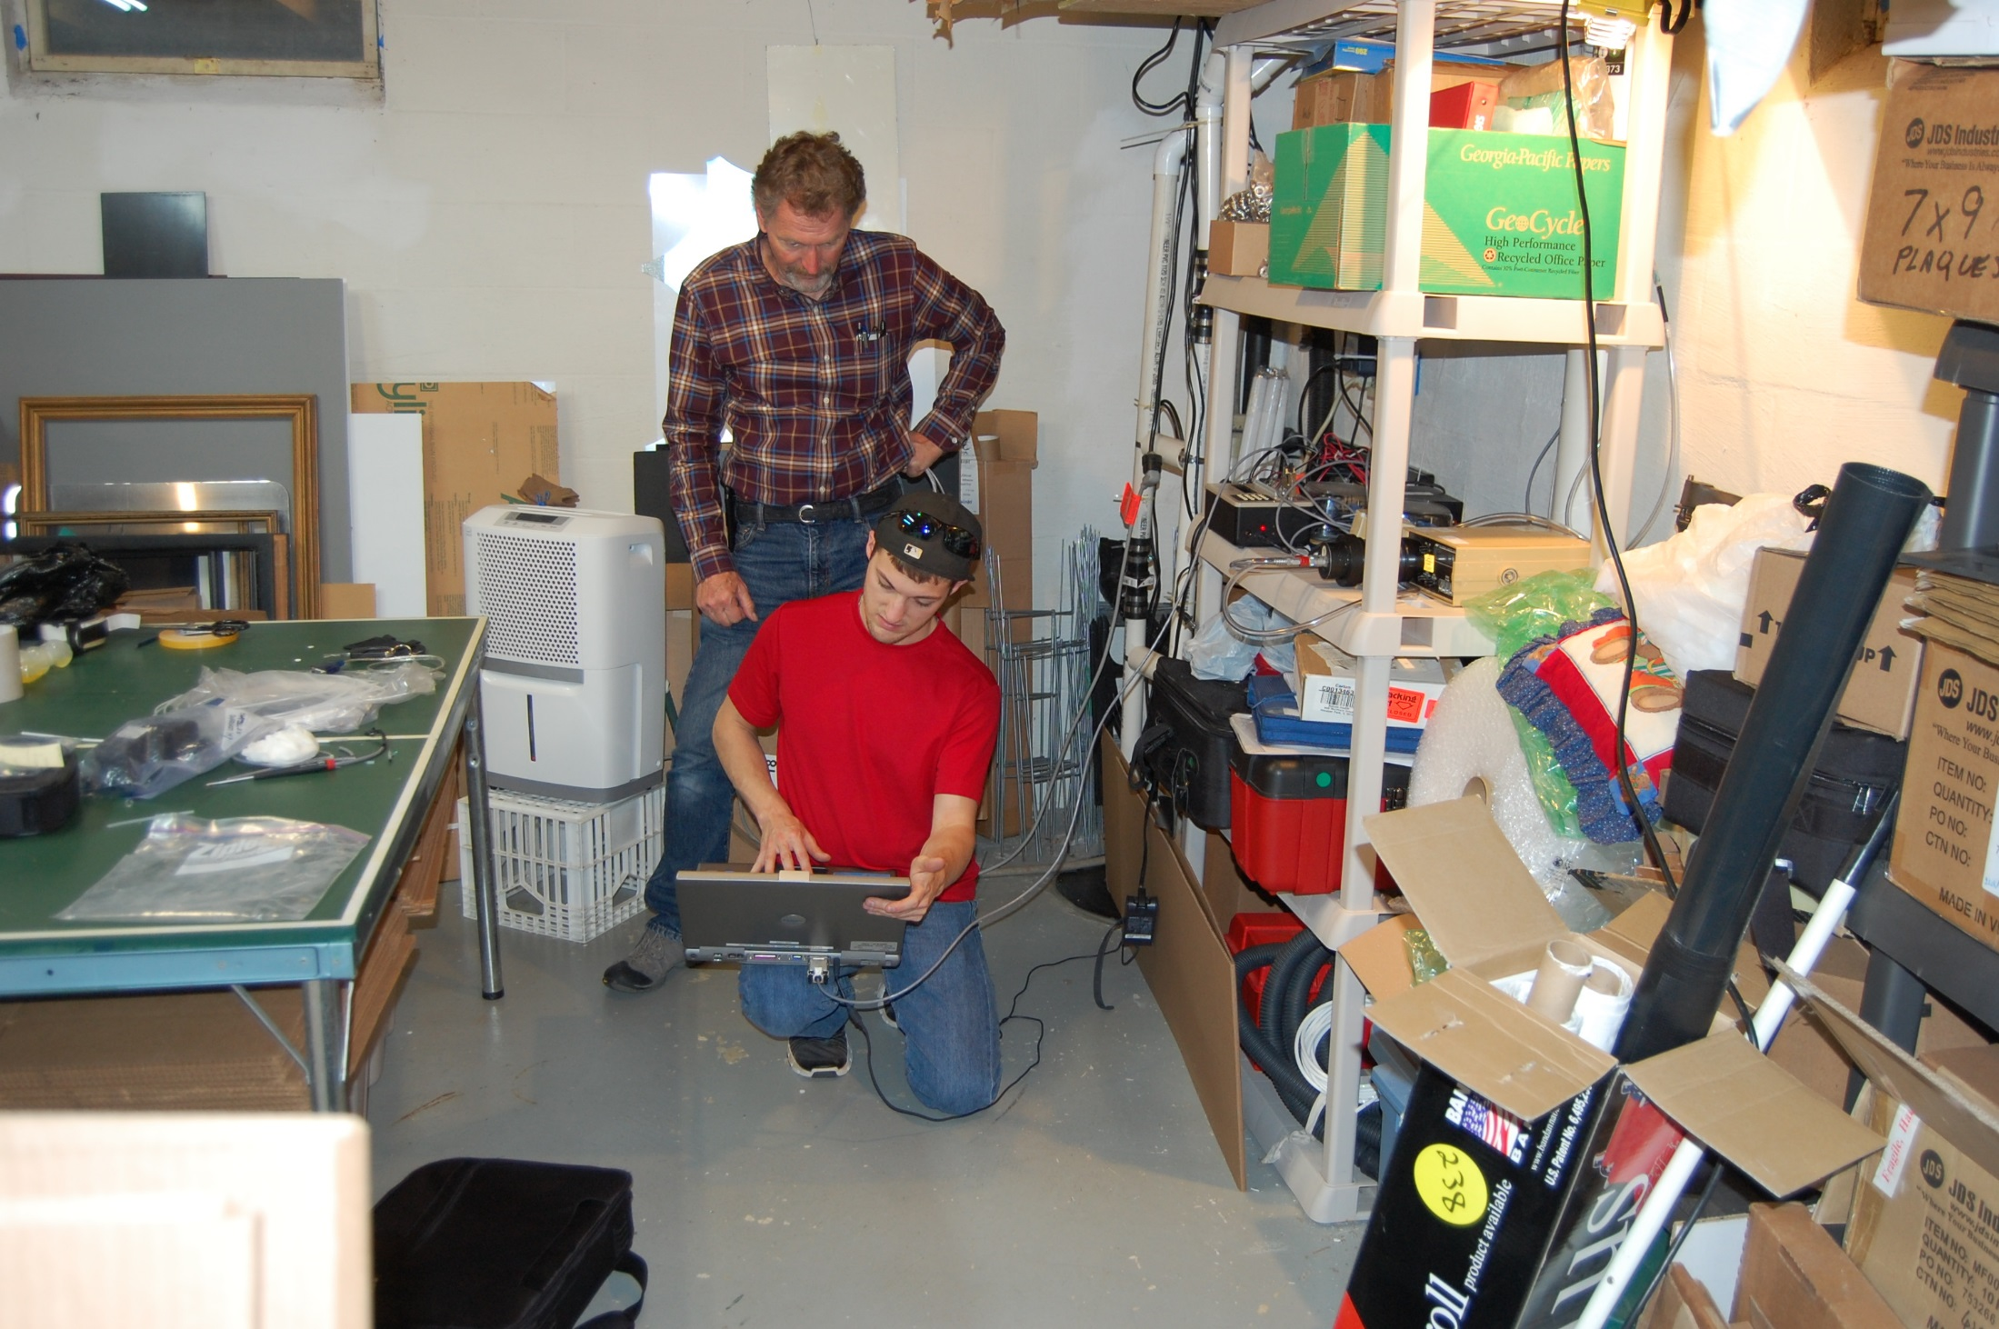
DEP/BRP Radon Division
Notes:
ER = (WL x 100)/ Rn

Slide 20
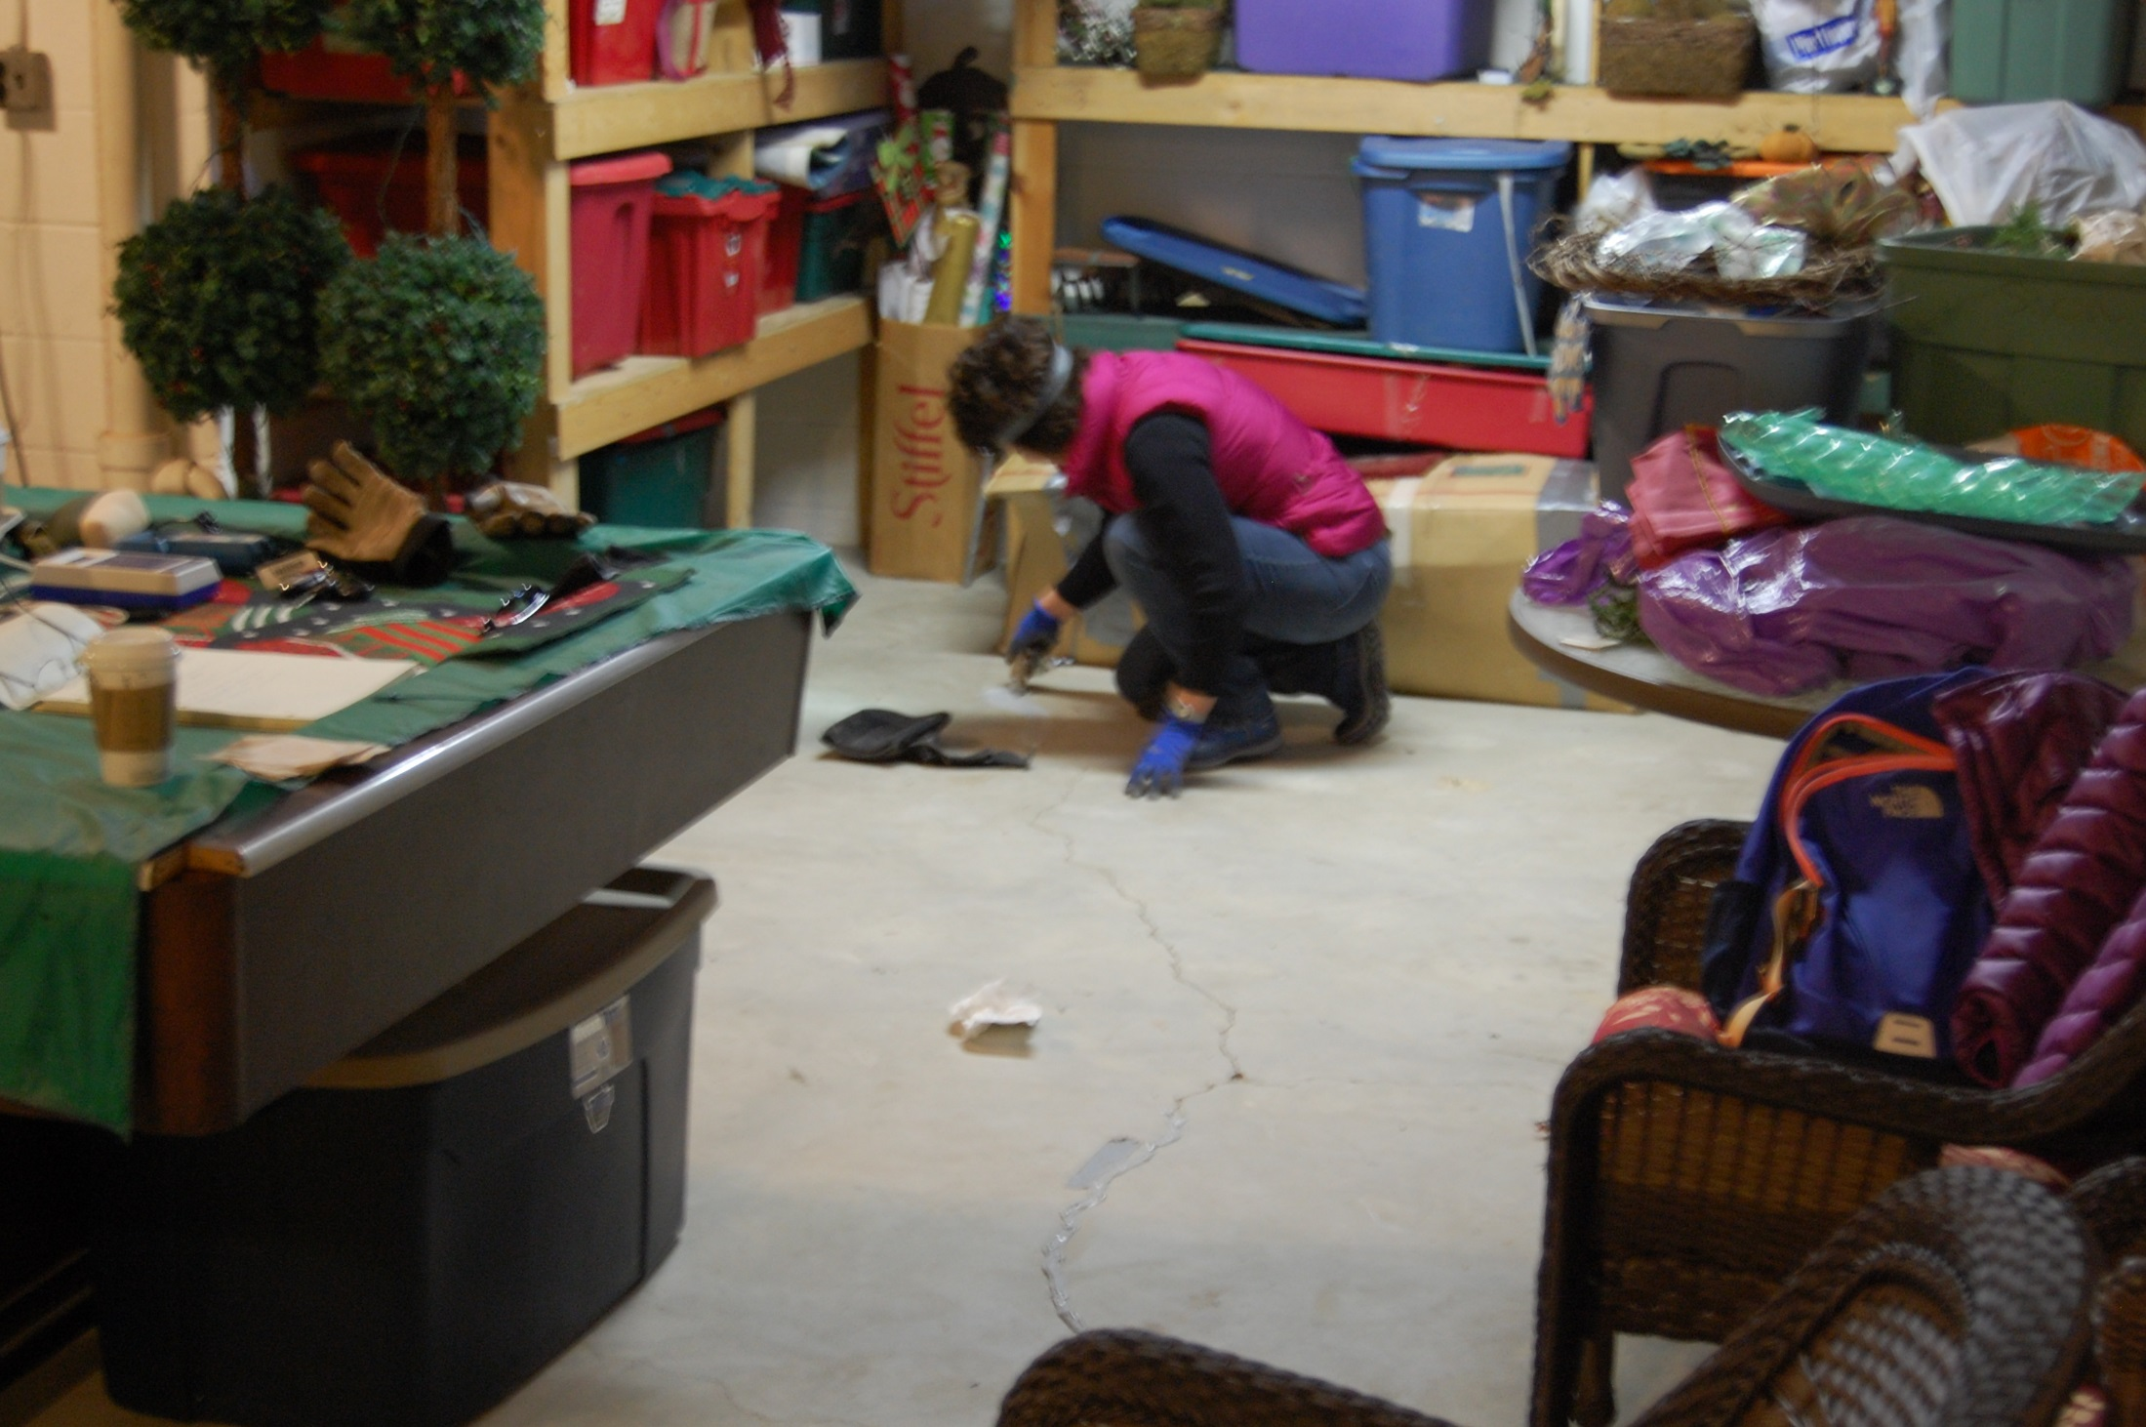
DEP/BRP Radon Division
Notes:
ER = (WL x 100)/ Rn

Slide 21

DEP/BRP Radon Division
Notes:
ER = (WL x 100)/ Rn

Slide 22

DEP/BRP Radon Division
Notes:
ER = (WL x 100)/ Rn

Slide 23
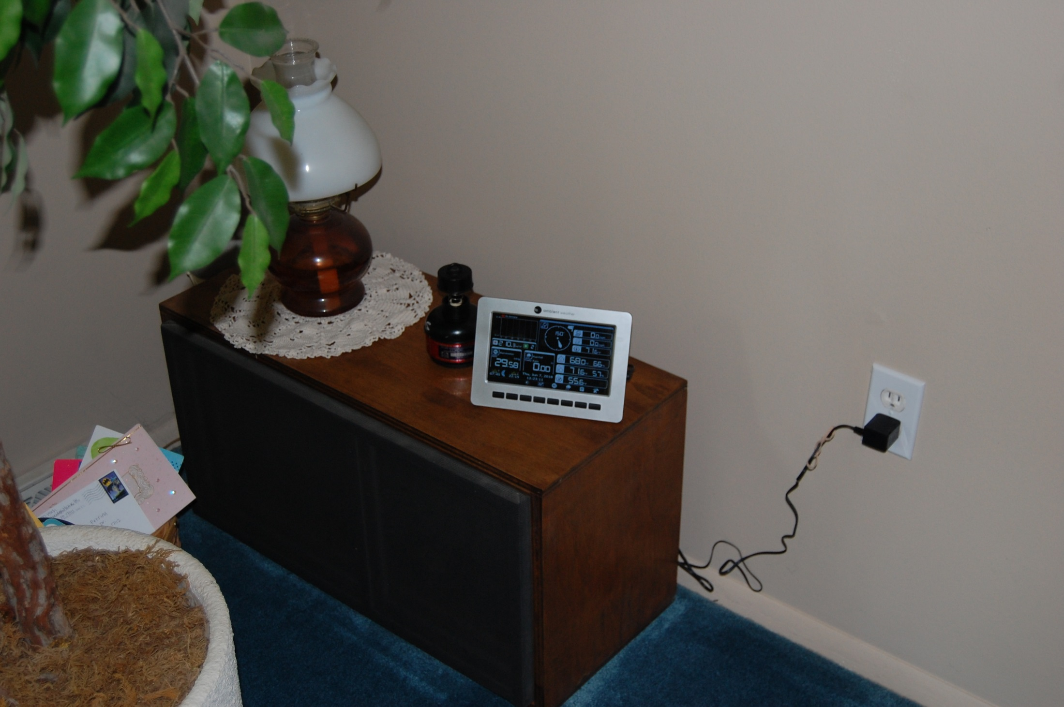
DEP/BRP Radon Division
Notes:
ER = (WL x 100)/ Rn

Slide 24
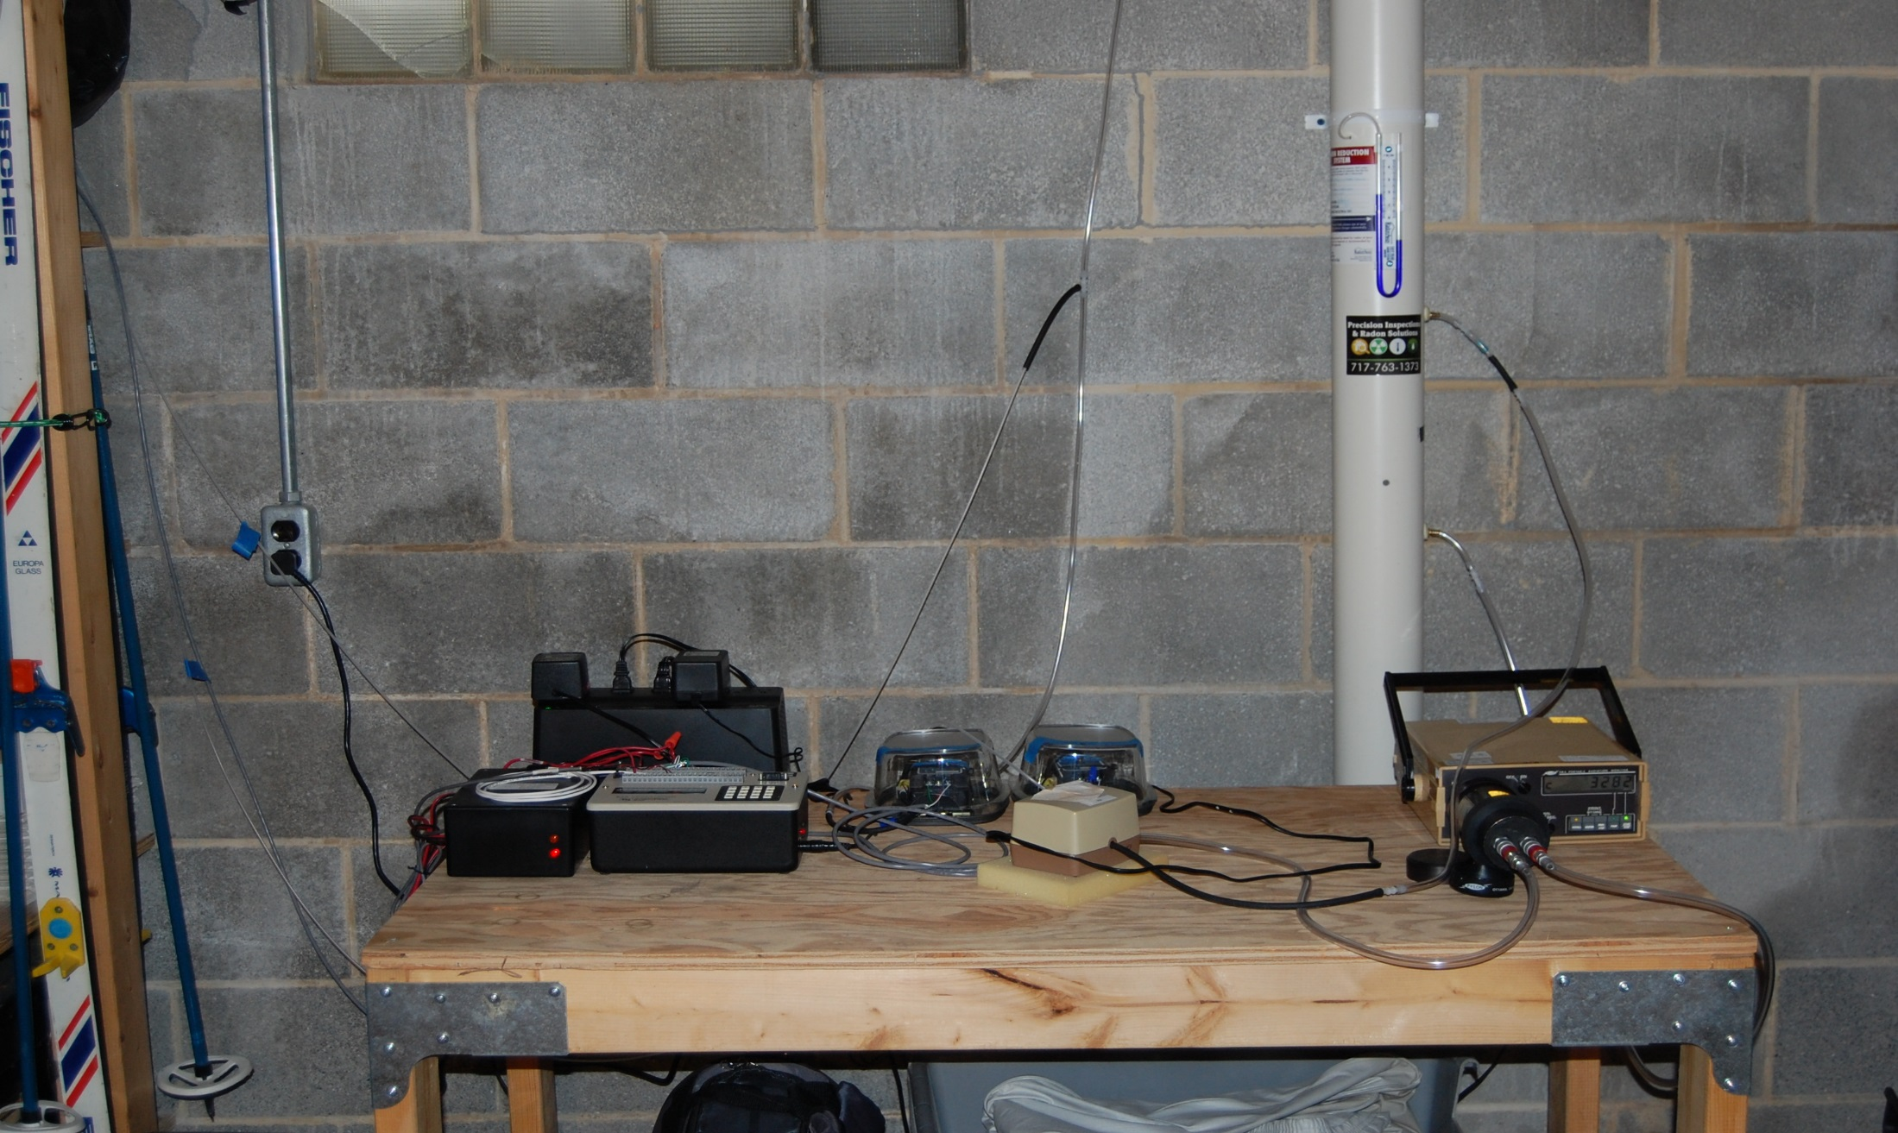
DEP/BRP Radon Division
Notes:
ER = (WL x 100)/ Rn

Slide 25
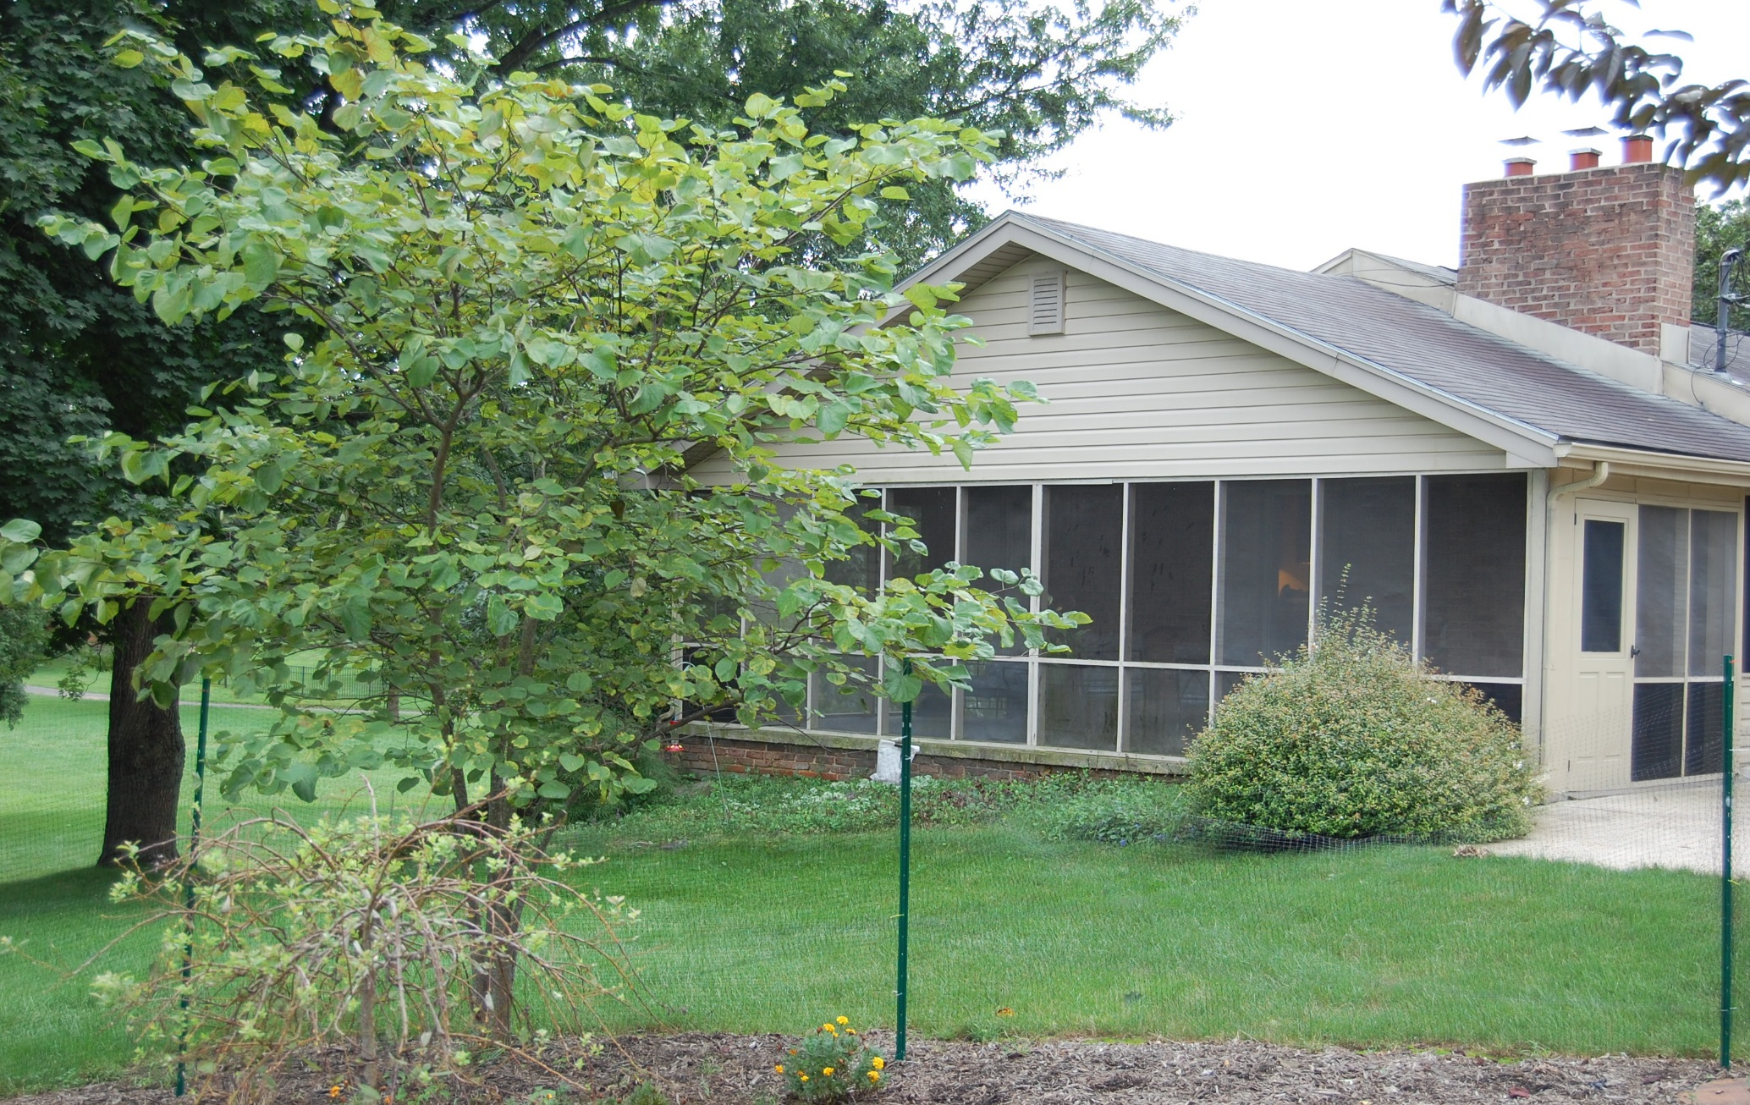
DEP/BRP Radon Division
Notes:
ER = (WL x 100)/ Rn

Slide 26
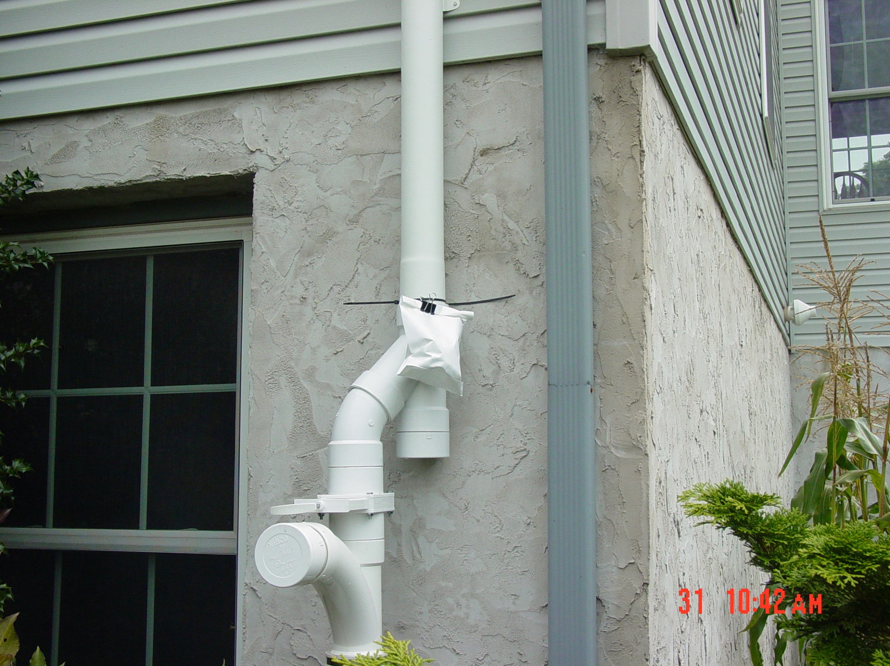
DEP/BRP Radon Division
Notes:
ER = (WL x 100)/ Rn

Slide 27
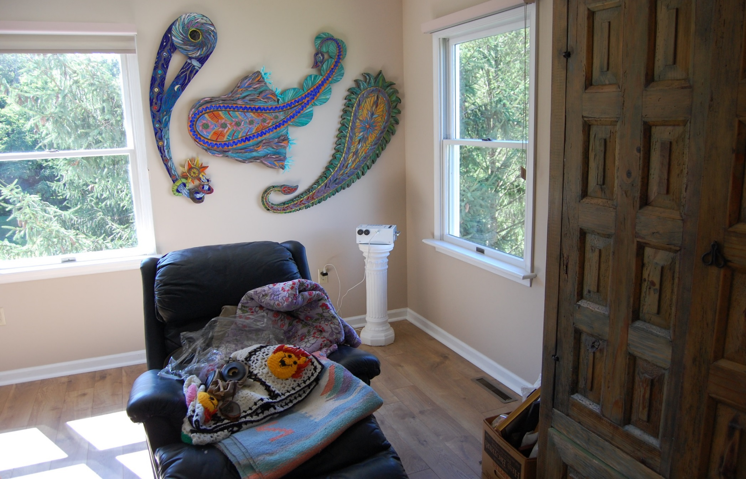
DEP/BRP Radon Division
Notes:
ER = (WL x 100)/ Rn

Slide 28
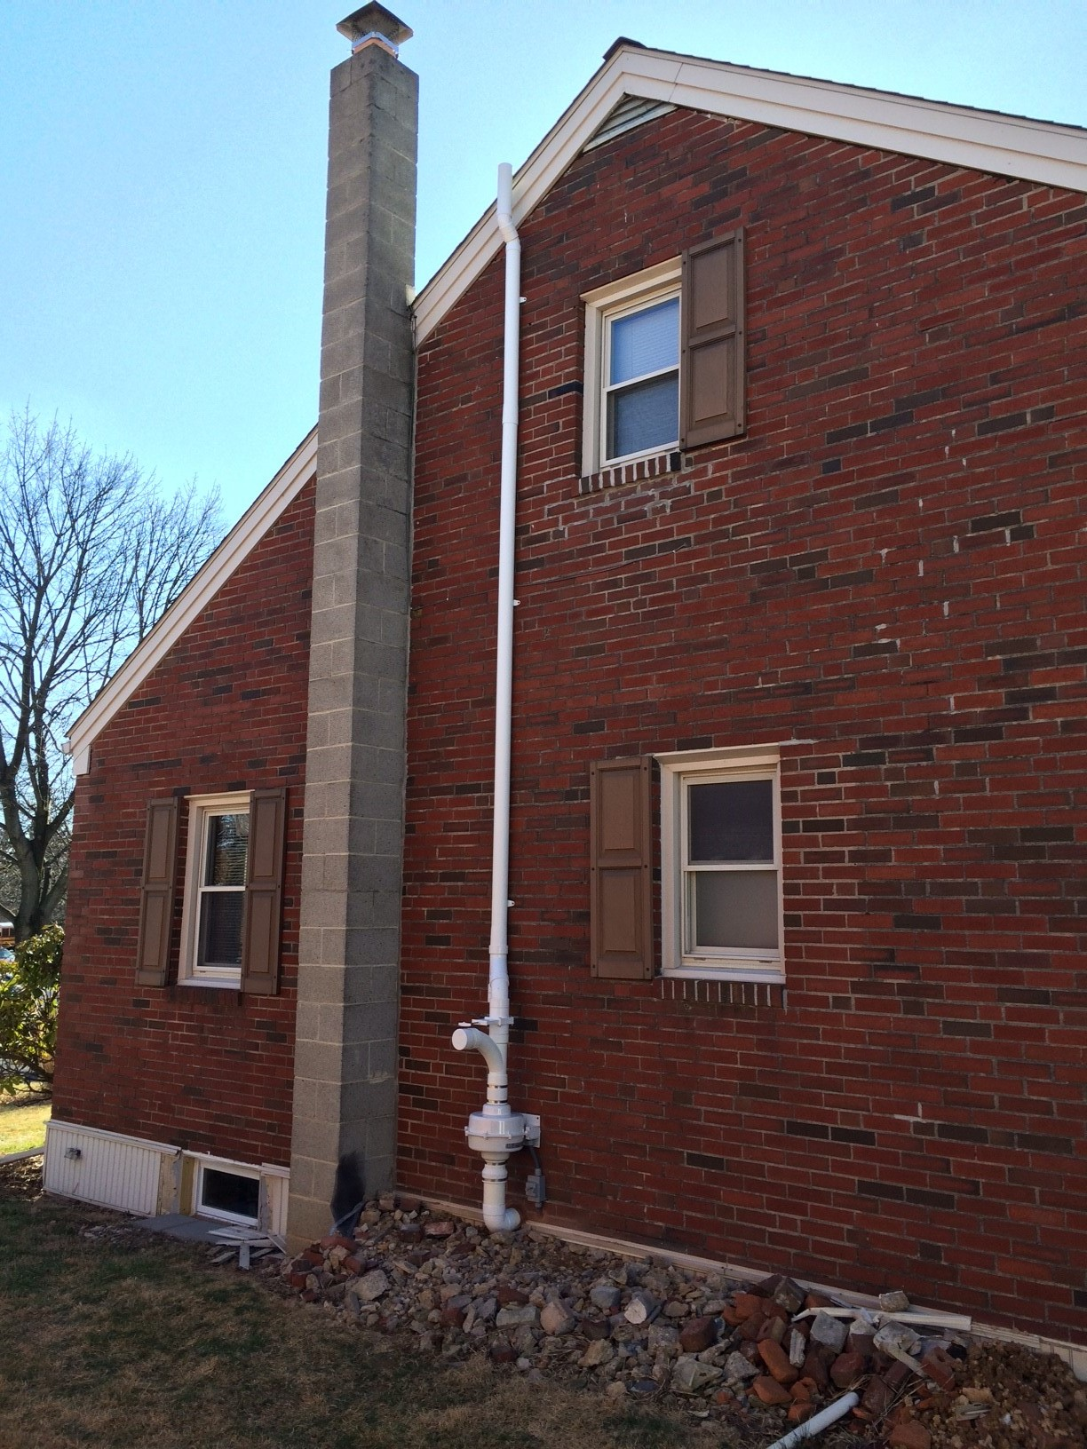
DEP/BRP Radon Division
Notes:
ER = (WL x 100)/ Rn

Slide 29
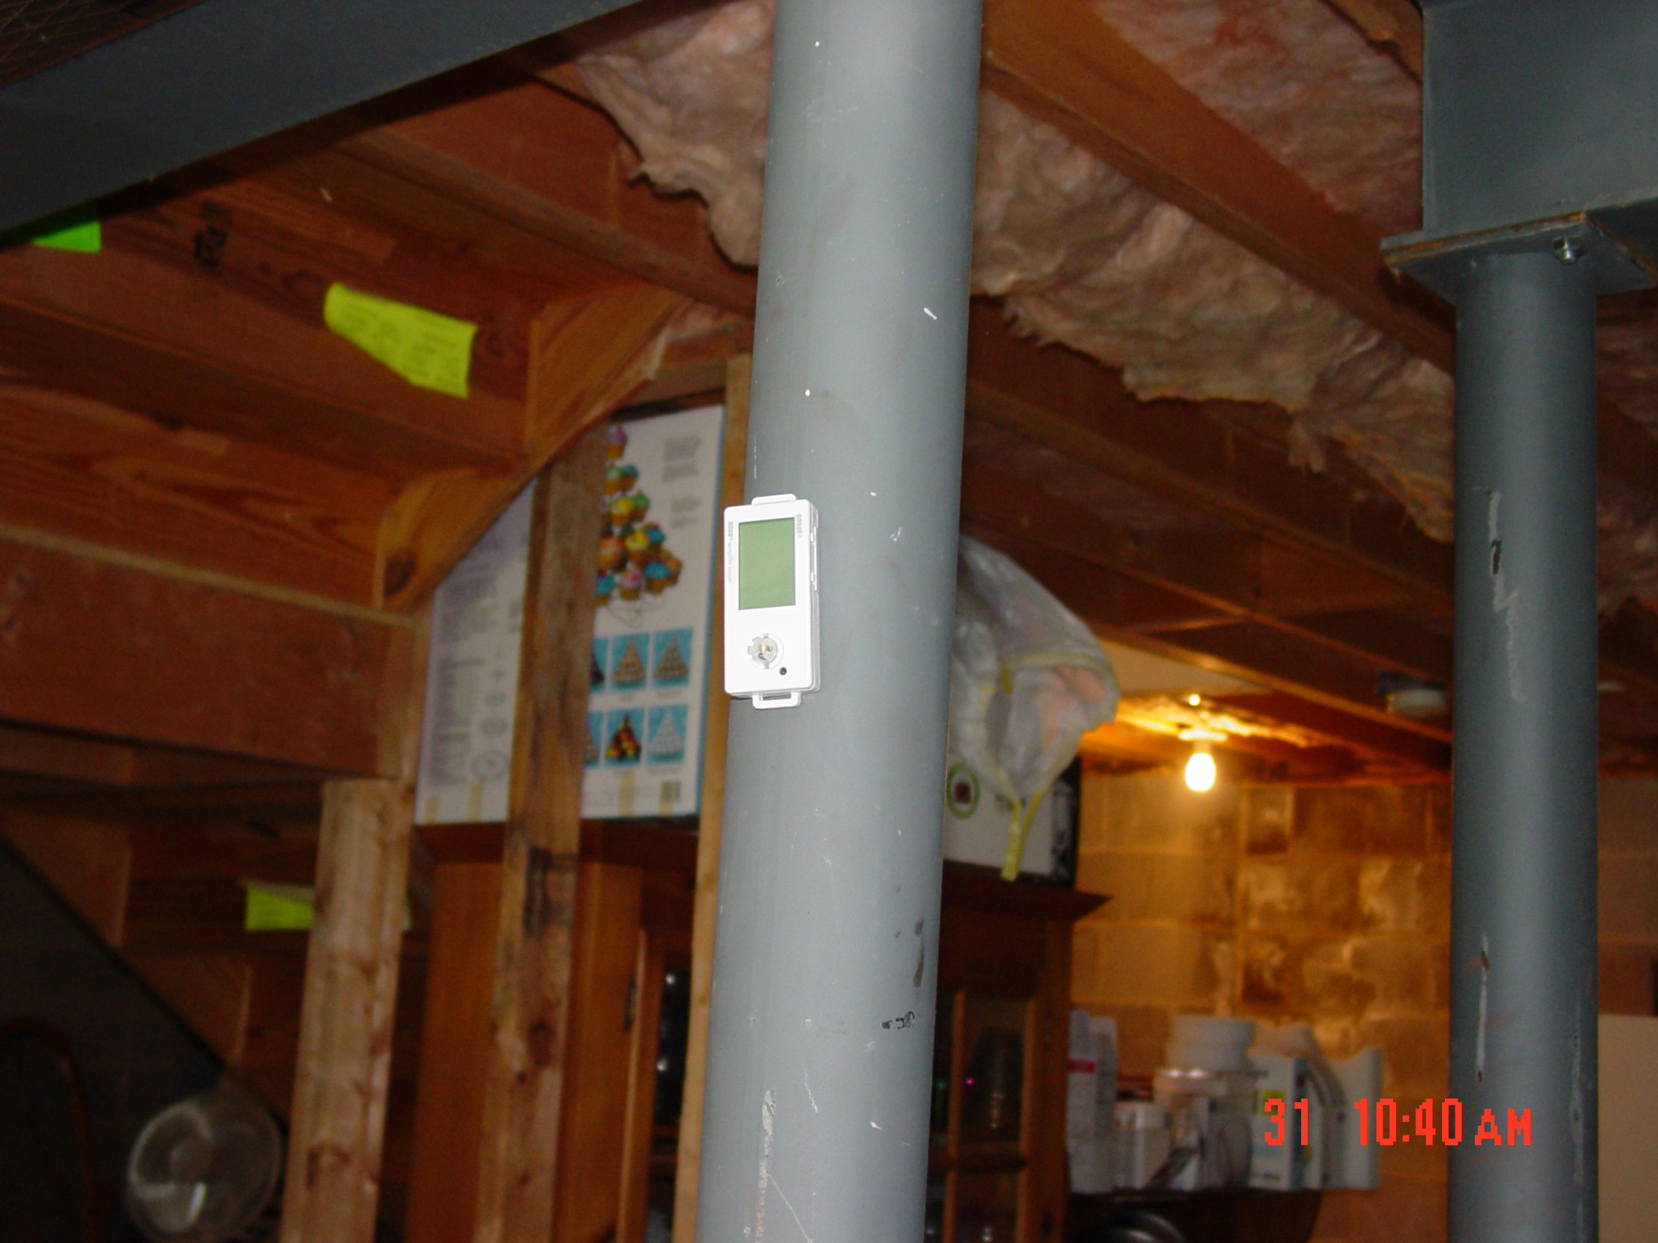
DEP/BRP Radon Division
Notes:
ER = (WL x 100)/ Rn

Slide 30
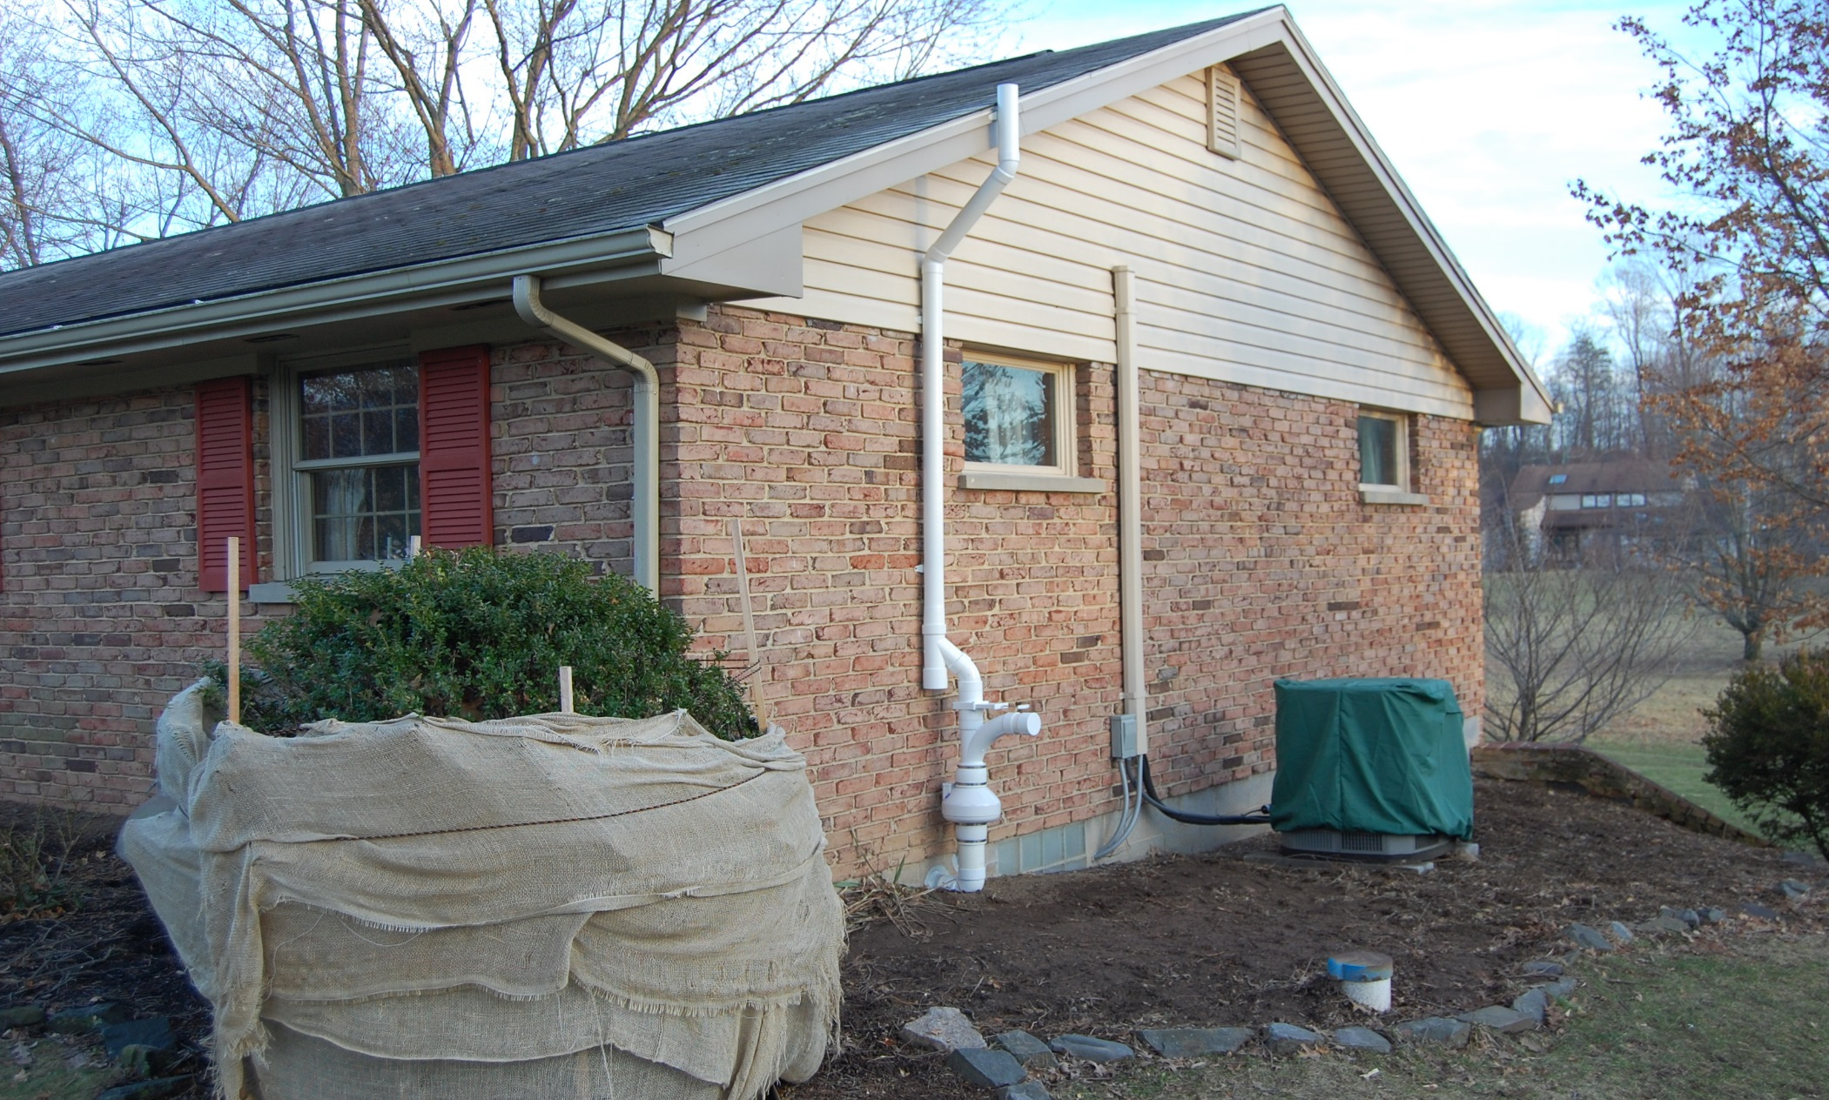
DEP/BRP Radon Division, Before
Notes:
ER = (WL x 100)/ Rn

Slide 31
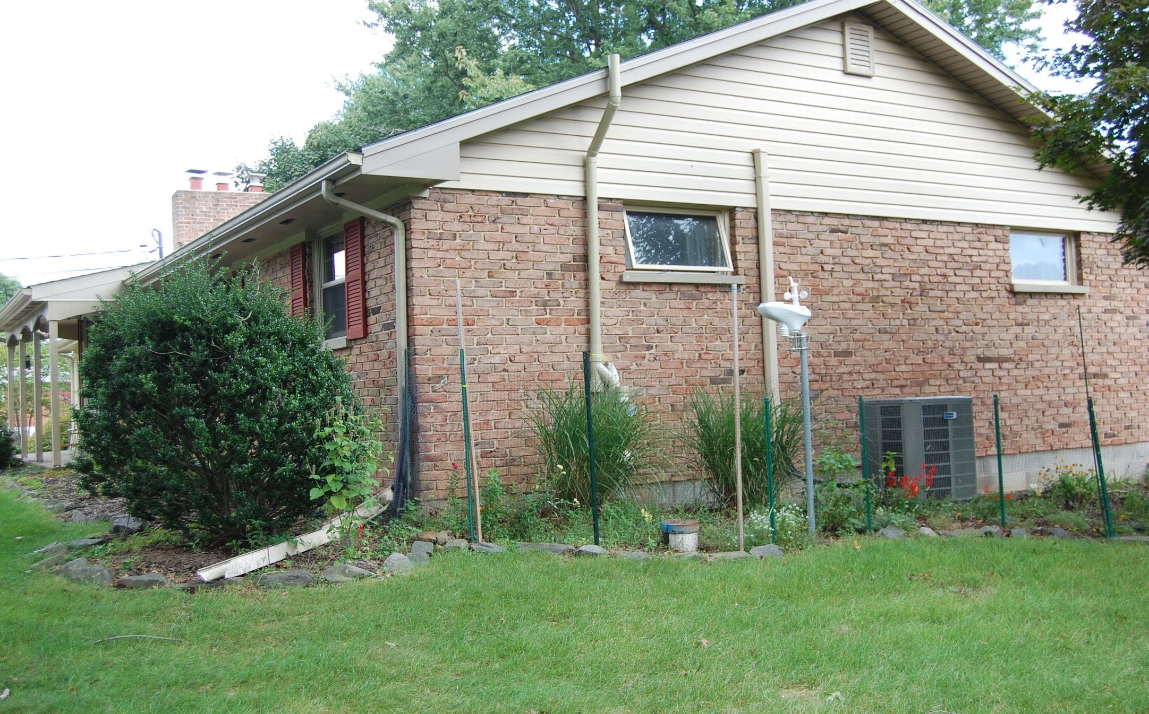
DEP/BRP Radon Division, After
Notes:
ER = (WL x 100)/ Rn

Slide 32

DEP/BRP Radon Division
Notes:
ER = (WL x 100)/ Rn

Slide 33
DEP/BRP Radon Division
Questions?
Contact Information:
www.dep.pa.gov
Click Radiation Protection
then click Radon
    800 237-2366
    717 783-3594

